Slide 1
Introduction to Javascript

Slide 2
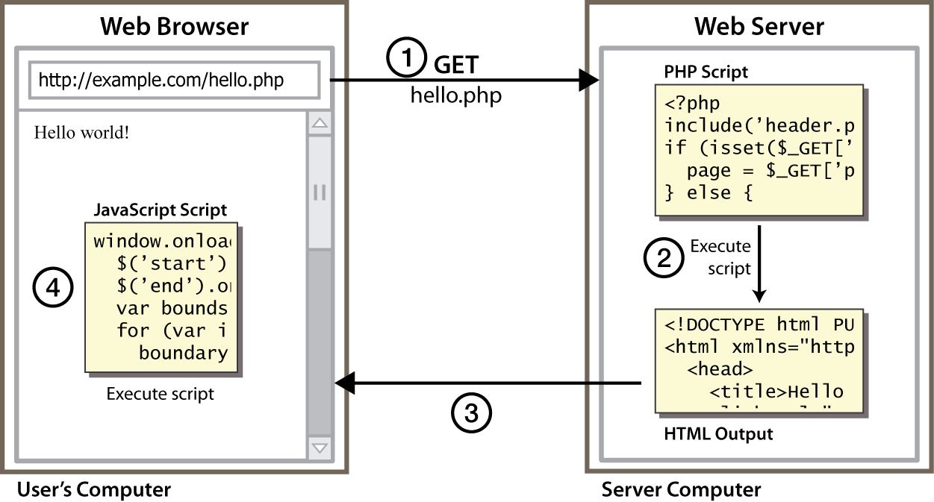
Client Side Scripting
Notes:
client-side script: code runs in browser after page is sent back from server
often this code manipulates the page or responds to user actions

Slide 3
Why use client-side programming?
Server side scripting (PHP or Python) already allows us to create dynamic web pages. Why also use client-side scripting?
client-side scripting (JavaScript) benefits:
usability: can modify a page without having to post back to the server (faster UI)
efficiency: can make small, quick changes to page without waiting for server
event-driven: can respond to user actions like clicks and key presses

Slide 4
Why use client-side programming?
server-side programming benefits:
security: has access to server's private data; client can't see source code
compatibility: not subject to browser compatibility issues
power: can write files, open connections to servers, connect to databases

Slide 5
What is Javascript?
a lightweight programming language ("scripting language")
used to make web pages interactive
insert dynamic text into HTML (ex: user name)
react to events (ex: page load user click)
get information about a user's computer (ex: browser type)
perform calculations on user's computer (ex: form validation)

Slide 6
What is Javascript?
a web standard (but not supported identically by all browsers)
NOT related to Java other than by name and some syntactic similarities

Slide 7
JavaScript vs. Server Side Script
similarities:
both are interpreted, not compiled
both are relaxed about syntax, rules, and types
both are case-sensitive
both have built-in regular expressions for powerful text processing

Slide 8
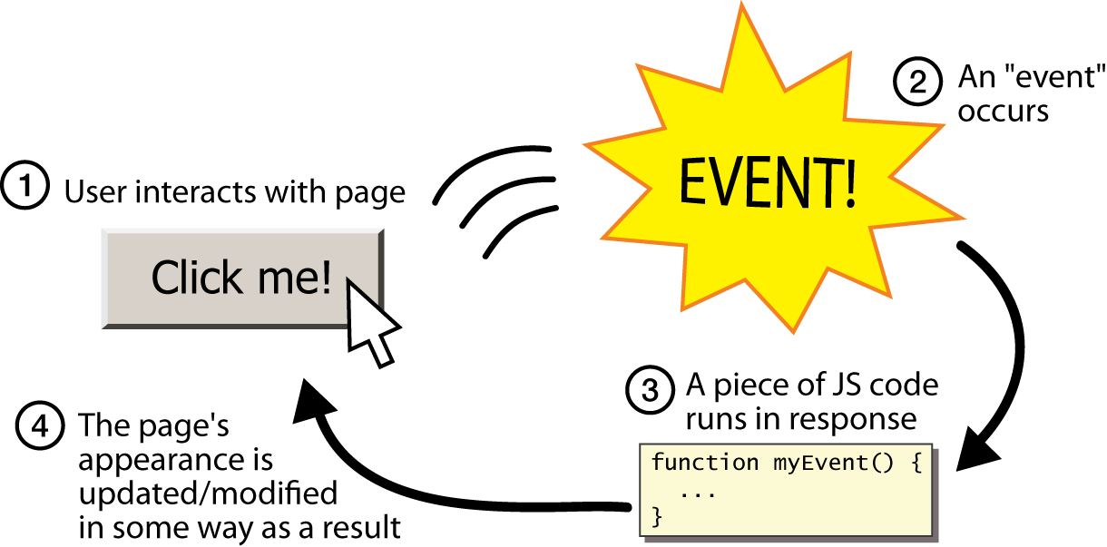
Event-driven programming
split breaks apart a string into an array using a delimiter
can also be used with regular expressions (seen later)
join merges an array into a single string, placing a delimiter between them

Slide 9
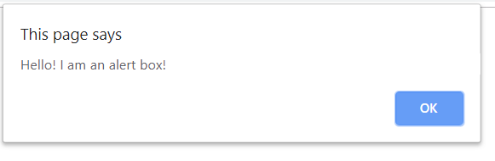
A JavaScript statement: alert
alert(“Hello! I am an alert box!"); JS
a JS command that pops up a dialog box with a message

Slide 10
Event-driven programming
JavaScript programs wait for user actions called events and respond to them
event-driven programming: writing programs driven by user events
Let's write a page with a clickable button that pops up a "Hello, World" window...

Slide 11
Buttons
<button>Click me!</button> HTML
button's text appears inside tag; can also contain images
To make a responsive button or other UI control:
choose the control (e.g. button) and event (e.g. mouse 1. click) of interest
write a JavaScript function to run when the event occurs
attach the function to the event on the control
Notes:
Reset is not working here! Debug! test1.html

Slide 12
JavaScript functions
function name() {
statement ;
statement ;
...
statement ;
} JS
function myFunction() {
alert("Hello!");
alert("How are you?");
} JS
the above could be the contents of example.js linked to our HTML page
statements placed into functions can be evaluated in response to user events

Slide 13
Event handlers
<element attributes onclick="function();">... HTML
<button onclick="myFunction();">Click me!</button> HTML
JavaScript functions can be set as event handlers
when you interact with the element, the function will execute
onclick is just one of many event HTML attributes we'll use
but popping up an alert window is disruptive and annoying
A better user experience would be to have the message appear on the page...

Slide 14
Event handlers
<p>Click the button to display an alert box.</p>
<button onclick="myFunction()">Try it</button>
<script>
function myFunction() {
alert("Hello! I am an alert box!");
}
</script>
HTML

Slide 15
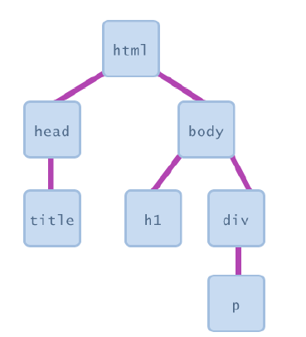
Document Object Model (DOM)
most JS code manipulates elements on an HTML page
we can examine elements' state
e.g. see whether a box is checked
we can change state
e.g. insert some new text into a div
we can change styles
e.g. make a paragraph red

Slide 16
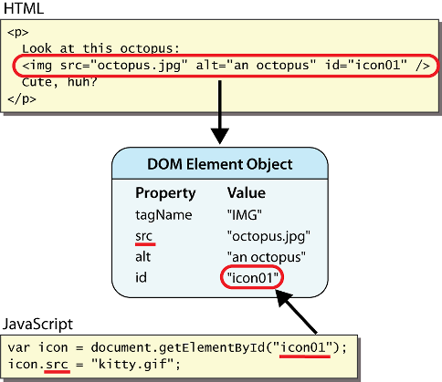
DOM element objects
Notes:
every element on the page has a corresponding DOM object access/modify the attributes of the DOM object with objectName.attributeName

Slide 17
Accessing elements: document.getElementById
var name = document.getElementById("id");
JS
<button onclick="changeText();">Click me!</button>
<span id="output">replace me</span>
<input id="textbox" type="text" /> HTML
function changeText() {
var span = document.getElementById("output");
var textBox = document.getElementById("textbox");
textbox.style.color = "red";
} JS
Notes:
span.innerHTML = textBox.value;

Slide 18
Accessing elements: document.getElementById
document.getElementById returns the DOM object for an element with a given id
can change the text inside most elements by setting the innerHTML property
can change the text in form controls by setting the value property

Slide 19
Changing element style: element.style
Attribute | Property or style object
color | color
padding | padding
background-color | backgroundColor
border-top-width | borderTopWidth
Font size | fontSize
Font famiy | fontFamily

Slide 20
Preetify
function changeText() {
//grab or initialize text here
// font styles added by JS:
text.style.fontSize = "13pt";
text.style.fontFamily = "Comic Sans MS";
text.style.color = "red";
} JS

Slide 21
Preetify
<body>
<p id="p1">
This is a text.
This is a text.
This is a text.
</p>
<input type="button" value="Hide text"
onclick="document.getElementById('p1').style.visibility
='hidden'">
<input type="button" value="Show text"
onclick="document.getElementById('p1').style.visibility
='visible'">
</body> JS

Slide 22
Preetify
<h2>JavaScript Functions</h2>
<p id="demo"></p>
<script>
document.getElementById("demo").innerHTML =
"The temperature is " + toCelsius(77) + " Celsius";
function toCelsius(fahrenheit) {
return (5/9) * (fahrenheit-32);
}
</script> JS

Slide 23
<script>
function bgChange(bg) {
document.body.style.background = bg;}
</script>
</head>
<body>
<h2>Change background color</h2>
<p>Mouse over the squares!</p>
<table style="width:300px;height:100px">
<tr>
<td onmouseover="bgChange(this.style.backgroundColor)"
onmouseout="bgChange('transparent')"
style="background-color:Khaki">
</td>
<td onmouseover="bgChange(this.style.backgroundColor)"
onmouseout="bgChange('transparent')"
style="background-color:PaleGreen">
</td>
<td onmouseover="bgChange(this.style.backgroundColor)"
onmouseout="bgChange('transparent')"
style="background-color:Silver">
</td>
</tr>
</table> JS

Slide 24
More Javascript Syntax

Slide 25
Variables
var name = expression; JS
var clientName = "Connie Client";
var age = 32;
var weight = 127.4; JS
variables are declared with the var keyword (case sensitive)
types are not specified, but JS does have types ("loosely typed")
Number, Boolean, String, Array, Object, Function, Null, Undefined
can find out a variable's type by calling typeof

Slide 26
Number type
var enrollment = 99;
var medianGrade = 2.8;
var credits = 5 + 4 + (2 * 3); JS
integers and real numbers are the same type (no int vs. double)
same operators: + - * / % ++ -- = += -= *= /= %=
similar precedence to Java
many operators auto-convert types: "2" * 3 is 6

Slide 27
Comments (same as Java)
// single-line comment
/* multi-line comment */ JS
identical to Java's comment syntax
recall: 4 comment syntaxes
HTML: <!-- comment -->
CSS/JS/PHP: /* comment */
Java/JS/PHP: // comment
PHP: # comment

Slide 28
Math object
var rand1to10 = Math.floor(Math.random() * 10 + 1);
var three = Math.floor(Math.PI); JS
methods: abs, ceil, cos, floor, log, max, min, pow, random, round, sin, sqrt, tan
properties: E, PI

Slide 29
Special values: null and undefined
var ned = null;
var benson = 9;
// at this point in the code,
// ned is null
// benson's 9
// caroline is undefined JS
undefined : has not been declared, does not exist
null : exists, but was specifically assigned an empty or null value
Why does JavaScript have both of these?

Slide 30
Logical operators
> < >= <= && || ! == != === !==
most logical operators automatically convert types:
5 < "7" is true
42 == 42.0 is true
"5.0" == 5 is true
=== and !== are strict equality tests; checks both type and value
"5.0" === 5 is false

Slide 31
Output in Javascript
<body>
<script>
document.write(5 + 6);
</script>
<p id="demo"></p>
<script>
document.getElementById("demo").innerHTML = 5 + 6;
</script>
<script>
window.alert(5 + 6);
</script>
<script>
console.log(5 + 6);
</script>
</body> JS

Slide 32
Example
<body>
<form>
1st Number : <input type="text" id="firstNumber" /><br>
2nd Number: <input type="text" id="secondNumber" /><br>
<input type="button" onClick="multiplyBy()" Value="Multiply" />
<input type="button" onClick="divideBy()"
Value="Divide" />
</form>
<p>The Result is : <br>
<span id = "result"></span>
</p>
</body> JS

Slide 33
Output in Javascript
<script>
function multiplyBy()
{
num1 = document.getElementById("firstNumber").value;
num2 = document.getElementById("secondNumber").value;
document.getElementById("result").innerHTML = num1 * num2;
}
function divideBy()
{
num1 = document.getElementById("firstNumber").value;
num2 = document.getElementById("secondNumber").value;
document.getElementById("result").innerHTML = (num1 / num2).toPrecision(3);
}
</script> JS

Slide 34
if/else statement (same as Java)
if (condition) {
statements;
} else if (condition) {
statements;
} else {
statements;
}
JS
identical structure to Java's if/else statement
JavaScript allows almost anything as a condition

Slide 35
Boolean type
var iLike190M = true;
var ieIsGood = "IE6" > 0; // false
if ("web devevelopment is great") { /* true */ }
if (0) { /* false */ } JS
any value can be used as a Boolean
"falsey" values: 0, 0.0, NaN, "", null, and undefined
"truthy" values: anything else
converting a value into a Boolean explicitly:
var boolValue = Boolean(otherValue);
var boolValue = !!(otherValue);

Slide 36
for loop (same as Java)
var sum = 0;
for (var i = 0; i < 100; i++) {
sum = sum + i;
} JS
var s1 = "hello";
var s2 = "";
for (var i = 0; i < s1.length; i++) {
s2 += s1.charAt(i) + s1.charAt(i);
}
// s2 stores "hheelllloo" JS

Slide 37
while loops (same as Java)
while (condition) {
statements;
} JS
do {
statements;
} while (condition); JS
break and continue keywords also behave as in Java

Slide 38
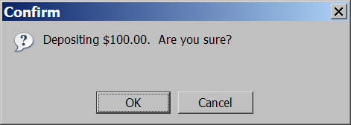
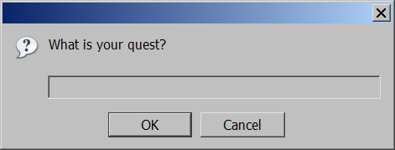
Popup boxes
alert("message"); // message
confirm("message"); // returns true or false
prompt("message"); // returns user input string JS

Slide 39
Arrays
var name = []; // empty array
var name = [value, value, ..., value]; // pre-filled
name[index] = value; // store element JS
var ducks = ["Huey", "Dewey", "Louie"];
var stooges = []; // stooges.length is 0
stooges[0] = "Larry"; // stooges.length is 1
stooges[1] = "Moe"; // stooges.length is 2
stooges[2] = "Curly"; // stooges.length is 3
stooges[3] = "Shemp"; // stooges.length is 4 JS
Notes:
two ways to initialize an array
length property (grows as needed when elements are added)

Slide 40
<h2>JavaScript For Loop</h2>
<p id="demo"></p>
<script>
var cars = ["BMW", "Volvo", "Saab", "Ford", "Fiat", "Audi"];
var text = "";
for (var i = 0; i < cars.length; i++) {
text += cars[i] + "<br>";
}
document.getElementById("demo").innerHTML = text;
var txt = 'JavaScript';
var x;
for (x of txt) {
document.write(x + "<br >");
}
</script> JS
Notes:
two ways to initialize an array
length property (grows as needed when elements are added)

Slide 41
<title>Multiplication Table</title>
<body>
<script type="text/javascript">
var rows = prompt("How many rows for your multiplication table?");
var cols = prompt("How many columns for your multiplication table?");
if(rows == "" || rows == null)
rows = 10;
if(cols== "" || cols== null)
cols = 10;
createTable(rows, cols);
function createTable(rows, cols)
{
var j=1;
var output = "<table border='1' width='500‘ cellspacing='0'cellpadding='5'>";
for(i=1;i<=rows;i++)
{
output = output + "<tr>";
while(j<=cols)
{
output = output + "<td>" + i*j + "</td>";
j = j+1;
}
output = output + "</tr>";
j = 1;
}
output = output + "</table>";
document.write(output);
}
</script>
</body> JS

Slide 42
Array methods
var a = ["Stef", "Jason"]; // Stef, Jason
a.push("Brian"); // Stef, Jason, Brian
a.unshift("Kelly"); // Kelly, Stef, Jason, Brian
a.pop(); // Kelly, Stef, Jason
a.shift(); // Stef, Jason
a.sort(); // Jason, Stef JS
array serves as many data structures: list, queue, stack, ...
methods: concat, join, pop, push, reverse, shift, slice, sort, splice, toString, unshift
push and pop add / remove from back
unshift and shift add / remove from front
shift and pop return the element that is removed

Slide 43
<h2>JavaScript Objects</h2>
<p id="demo"></p>
<script>
var person = {
firstName : "John",
lastName : "Doe",
age : 50,
eyeColor : "blue"
};
document.getElementById("demo").innerHTML =
person.firstName + " is " + person.age + " years old.";
</script> JS

Slide 44
String type
var s = "Connie Client";
var fName = s.substring(0, s.indexOf(" ")); // "Connie"
var len = s.length; // 13
var s2 = 'Melvin Merchant'; JS
methods: charAt, charCodeAt, fromCharCode, indexOf, lastIndexOf, replace, split, substring, toLowerCase, toUpperCase
charAt returns a one-letter String (there is no char type)
length property (not a method as in Java)
Strings can be specified with "" or ''
concatenation with + :
1 + 1 is 2, but "1" + 1 is "11"

Slide 45
More about String
escape sequences behave as in Java: \' \" \& \n \t \\
converting between numbers and Strings:
var count = 10;
var s1 = "" + count; // "10"
var s2 = count + " , ah ah ah!"; // "10 bananas, ah ah ah!"
var n1 = parseInt("42 is the answer"); // 42
var n2 = parseFloat("booyah"); // NaN JS
accessing the letters of a String:
var firstLetter = s[0]; // fails in IE
var firstLetter = s.charAt(0); // does work in IE
var lastLetter = s.charAt(s.length - 1); JS

Slide 46
Splitting strings: split and join
var s = "the quick brown fox";
var a = s.split(" "); // ["the", "quick", "brown", "fox"]
a.reverse(); // ["fox", "brown", "quick", "the"]
s = a.join("!"); // "fox!brown!quick!the" JS
split breaks apart a string into an array using a delimiter
can also be used with regular expressions (seen later)
join merges an array into a single string, placing a delimiter between them

Slide 47
Strings examples
<body>
<script>
var str = "Hello World!";
document.write(str[0] + "<br>"); // Prints: H
document.write(str[6] + "<br>"); // Prints: W
document.write(str[str.length - 1] + "<br>"); // Prints: !
document.write(str[30]); // Prints: undefined
</script>
</body> JS

Slide 48
Strings examples
<body>
<script>
var str = "INTERSTELLAR";
var strArr = str.split("");
document.write(strArr[0] + "<br>"); // Prints: I
document.write(strArr[1] + "<br>"); // Prints: N
document.write(strArr[strArr.length - 1]); // Prints: R
document.write("<hr>"); // Prints: N
// Loop through all the elements of the characters array and print them
for(var i in strArr) {
document.write("<br>" + strArr[i]);
}
</script>
</body> JS

Slide 49
Strings examples
<!DOCTYPE html>
<html lang="en">
<head>
<meta charset="utf-8">
<title>JavaScript Split a String into an Array</title>
</head>
<body>
<script>
var fruitsStr = "Apple, Banana, Mango, Orange, Papaya";
var fruitsArr = fruitsStr.split(", ");
document.write(fruitsArr[0] + "<br>"); // Prints: Apple
document.write(fruitsArr[2] + "<br>"); // Prints: Mango
document.write(fruitsArr[fruitsArr.length - 1]); // Prints: Papaya
document.write("<hr>");
// Loop through all the elements of the fruits array
for(var i in fruitsArr) {
document.write("<p>" + fruitsArr[i] + "</p>");
}
</script>
</body>
</html> JS

Slide 50
The DOM tree

Slide 51
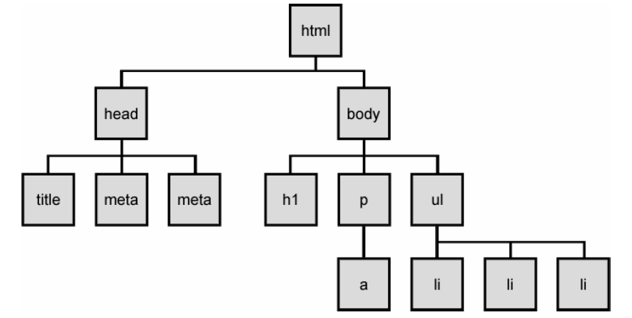
The DOM tree
Notes:
The elements of a page are nested into a tree-like structure of objects
the DOM has properties and methods for traversing this tree

Slide 52



Types of DOM nodes
<p>
This is a paragraph of text with a
<a href="/path/page.html">link in it</a>.
</p> HTML
element nodes (HTML tag)
can have children and/or attributes
text nodes (text in a block element)
attribute nodes (attribute/value pair)
text/attributes are children in an element node
cannot have children or attributes
not usually shown when drawing the DOM tree

Slide 53
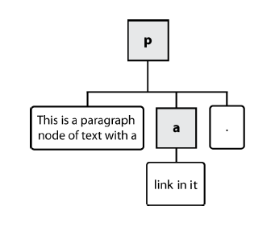
Types of DOM nodes
<p>
This is a paragraph of text with a
<a href="/path/page.html">link in it</a>.
</p> HTML

Slide 54
Traversing the DOM tree
name(s) | description
firstChild, lastChild | start/end of this node's list of children
childNodes | array of all this node's children
nextSibling, previousSibling | neighboring nodes with the same parent
parentNode | the element that contains this node
complete list of DOM node properties
browser incompatiblity information

Slide 55
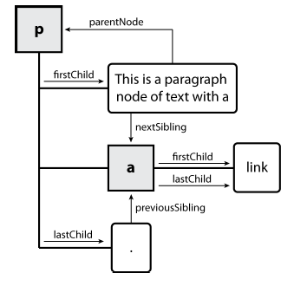
DOM tree traversal example
<p id="foo">This is a paragraph of text with a
<a href="/path/to/another/page.html">link</a>.</p> HTML

Slide 56
Elements vs text nodes
<div>
<p>
This is a paragraph of text with a
<a href="page.html">link</a>.
</p>
</div> HTML
Q: How many children does the div above have?
A: 3
an element node representing the <p>
two text nodes representing "\n\t" (before/after the paragraph)
Q: How many children does the paragraph have? The a tag?

Slide 57
Prototype's DOM element methods
absolutize | addClassName | classNames | cleanWhitespace | clonePosition
cumulativeOffset | cumulativeScrollOffset | empty | extend | firstDescendant
getDimensions | getHeight | getOffsetParent | getStyle | getWidth
hasClassName | hide | identify | insert | inspect
makeClipping | makePositioned | match | positionedOffset | readAttribute
recursivelyCollect | relativize | remove | removeClassName | replace
scrollTo | select | setOpacity | setStyle | show
toggle | toggleClassName | undoClipping | undoPositioned | update
viewportOffset | visible | wrap | writeAttribute
Notes:
categories: CSS classes, DOM tree traversal/manipulation, events, styles

Slide 58
Prototype's DOM tree traversal methods
method(s) | description
ancestors, up | elements above this one
childElements, descendants, down | elements below this one (not text nodes)
siblings, next, nextSiblings, previous, previousSiblings, adjacent | elements with same parent as this one (not text nodes)
Notes:
Prototype strips out the unwanted text nodes
notice that these are methods, so you need ()

Slide 59
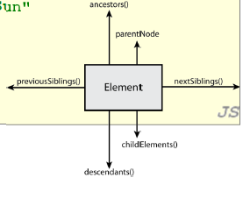
Prototype's DOM tree traversal methods
// alter siblings of "main" that do not contain "Sun"
var sibs = $("main").siblings();
for (var i = 0; i < sibs.length; i++) {
if (sibs[i].innerHTML.indexOf("Sun") < 0) {
sibs[i].innerHTML += " Sunshine";
}
} JS
Notes:
Prototype strips out the unwanted text nodes
notice that these are methods, so you need ()

Slide 60
Selecting groups of DOM objects
methods in document and other DOM objects for accessing descendants:
name | description
getElementsByTagName | returns array of descendents with the given tag, such as "div"
getElementsByName | returns array of descendants with the given name attribute (mostly useful for accessing form controls)

Slide 61
Getting all elements of a certain type
var allParas = document.getElementsByTagName("p");
for (var i = 0; i < allParas.length; i++) {
allParas[i].style.backgroundColor = "yellow";
} JS
<body>
<p>This is the first paragraph</p>
<p>This is the second paragraph</p>
<p>You get the idea...</p>
</body> HTML

Slide 62
Combining with getElementById
var addrParas = $("address").getElementsByTagName("p");
for (var i = 0; i < addrParas.length; i++) {
addrParas[i].style.backgroundColor = "yellow";
} JS
<p>This won't be returned!</p>
<div id="address">
<p>1234 Street</p>
<p>Atlanta, GA</p>
</div> HTML

Slide 63
Prototype's methods for selecting elements
var gameButtons = $("game").select("button.control");
for (var i = 0; i < gameButtons.length; i++) {
gameButtons[i].style.color = "yellow";
} JS
Prototype adds methods to the document object
(and all DOM element objects) for selecting groups of elements:
getElementsByClassName | array of elements that use given class attribute
select | array of descendants that match given CSS selector, such as "div#sidebar ul.news > li"

Slide 64
Prototype's methods for selecting elements
<style>
#container {
width: 400px;
height: 400px;
position: relative;
background: yellow;
}
#animate {
width: 50px;
height: 50px;
position: absolute;
background-color: red;
}
</style>

Slide 65
Prototype's methods for selecting elements
<body>
<p><button onclick="myMove()">Click Me</button></p>
<div id ="container">
<div id ="animate"></div>
</div>
<script>
function myMove() {
var elem = document.getElementById("animate");
var pos = 0;
var id = setInterval(frame, 5);
function frame() {
if (pos == 350) {
clearInterval(id);
} else {
pos++;
elem.style.top = pos + "px";
elem.style.left = pos + "px";
}
}
}
</script>
</body>

Slide 66
The $$ function
var arrayName = $$("CSS selector"); JS
// hide all "announcement" paragraphs in the "news" //section
var paragraphs = $$("div#news p.announcement");
for (var i = 0; i < paragraphs.length; i++) {
paragraphs[i].hide();
} JS
$$ returns an array of DOM elements that match the given CSS selector
like $ but returns an array instead of a single DOM object
a shorthand for document.select
useful for applying an operation each one of a set of elements

Slide 67
Common issues with $$
// get all buttons with a class of "control"
var gameButtons = $$("control");
var gameButtons = $$(".control"); JS
// set all buttons with a class of "control" to have red text
$$(".control").style.color = "red";
var gameButtons = $$(".control");
for (var I = 0; i < gameButtons.length; i++) {
gameButtons[i].style.color = "red";
} JS
Q: Can I still select a group of elements using $$ even if my CSS file doesn't have any style rule for that same group? (A: Yes!)

Slide 68
Creating new nodes
name | description
document.createElement("tag") | creates and returns a new empty DOM node representing an element of that type
document.createTextNode("text") | creates and returns a text node containing given text
// create a new <h2> node
var newHeading = document.createElement("h2");
newHeading.innerHTML = "This is a heading";
newHeading.style.color = "green"; JS
merely creating a node does not add it to the page
you must add the new node as a child of an existing element on the page...

Slide 69
Modifying the DOM tree
name | description
appendChild(node) | places given node at end of this node's child list
insertBefore(new, old) | places the given new node in this node's child list just before old child
removeChild(node) | removes given node from this node's child list
replaceChild(new, old) | replaces given child with new node
var p = document.createElement("p");
p.innerHTML = "A paragraph!";
$("main").appendChild(p); JS

Slide 70
Removing a node from the page
function slideClick() {
var bullets = document.getElementsByTagName("li");
for (var i = 0; i < bullets.length; i++) {
if (bullets[i].innerHTML.indexOf("children") >= 0) {
bullets[i].remove();
}
}
} JS
each DOM object has a removeChild method to remove its children from the page
Prototype adds a remove method for a node to remove itself

Slide 71
DOM versus innerHTML hacking
Why not just code the previous example this way?
function slideClick() {
$("thisslide").innerHTML += "<p>A paragraph!</p>";
} JS
Imagine that the new node is more complex:
ugly: bad style on many levels (e.g. JS code embedded within HTML)
error-prone: must carefully distinguish " and '
can only add at beginning or end, not in middle of child list
function slideClick() {
this.innerHTML += "<p style='color: red; " +
"margin-left: 50px;' " +
"onclick='myOnClick();'>" +
"A paragraph!</p>";
} JS

Slide 72
Problems with reading/changing styles
window.onload = function() {
$("clickme").onclick = biggerFont;
};
function biggerFont() {
var size = parseInt($("clickme").style.fontSize);
size += 4;
$("clickMe").style.fontSize = size + "pt";
} JS
style property lets you set any CSS style for an element
problem: you cannot (usually) read existing styles with it

Slide 73
Accessing styles in Prototype
function biggerFont() {
// turn text yellow and make it bigger
var size = parseInt($("clickme").getStyle("font-size"));
$("clickme").style.fontSize = (size + 4) + "pt";
} JS
getStyle function added to DOM object allows accessing existing styles
addClassName, removeClassName, hasClassName manipulate CSS classes

Slide 74
Common bug: incorrect usage of existing styles
this.style.top = this.getStyle("top") + 100 + "px";
// bad! JS
the above example computes e.g. "200px" + 100 + "px" , which would evaluate to "200px100px"
a corrected version:
this.style.top = parseInt(this.getStyle("top")) + 100 + "px"; // correct JS

Slide 75
Setting CSS classes in Prototype
function highlightField() {
// turn text yellow and make it bigger
if (!$("text").hasClassName("invalid")) {
$("text").addClassName("highlight");
}
} JS
addClassName, removeClassName, hasClassName manipulate CSS classes
similar to existing className DOM property, but don't have to manually split by spaces

Slide 76
Example: createElements
<html>
<head>
<script src=" https://ajax.googleapis.com/ajax/libs/prototype/1.7.0.0/prototype.js " type="text/javascript"></script>
<script src="paragraph.js " type="text/javascript"></script>
</head>
<body>
<div id="paragrapharea">
<button id="add">Add a paragraph</button>
</div>
</body>
</html>

Slide 77
Example: createElements
window.onload = function(){
var button = $("add");
button.onclick = addParagraphClick;
}
function addParagraphClick(){
var paragraph = document.createElement("p");
paragraph.innerHTML = "All work and no play makes Jack a dull boy";
var area = $("paragrapharea");
area.appendChild(paragraph);
}
function addListClick(){
} JS

Slide 78
Javascript Exercises
Create a webpage with an of Homer Simpson image at the center of the page. Develop a script that prints an alert: “Duh, you are hovering!!” every time the mouse crosses over the image.
Add 5 buttons to your webpage: red, yellow, green, black, and silver. Every time you click on one of these buttons the background should take the corresponding color.

